Slide 1
ADT Implementations: Templates and Standard Containers

Slide 2
Chapter Contents
Introduction: The Evolution of Reusability and Genericity
Function Genericity – Overloading and Templates
Class Genericity – Templates
The vector Container
Case Study: Counting Computer Logins
Multidimensional vectors (Optional)
Other Standard Containers – deque, stack, queue
Bitsets and Valarrays (Optional)

Slide 3
Chapter Objectives
Survey how reusability and genericity themes have evolved in programming languages
Study function templates
Study class templates
Look at vector in detail as an example of a container class template
(Optional) Study multidimensional vectors
Look at some of the other C++ standard containers (deque, stack, and queue)
(Optional) Introduce valarrays and bitsets as array-based templates

Slide 4
Evolution of Reusability, Genericity
Major theme in development of programming languages
  Reuse code
  Avoid repeatedly reinventing the wheel
Trend contributing to this
  Use of generic code
  Can be used with different types of data

Slide 5
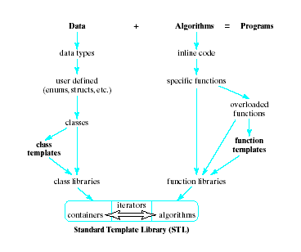
Evolution of Reusability, Genericity
Evolution of algorithmic features of programming languages
Evolution of data features of programming languages
Niklaus Wirth
(inventor of Pascal)
  Stressed data and
  algorithms cannot
  be separated

Slide 6
Function Genericity
Overloading and Templates
Initially code was reusable by encapsulating it within functions
Example lines of code to swap values stored in two variables
  Instead of rewriting those 3 lines
  Place in a function
  void swap (int & first, int & second)
  { int temp = first;
  first = second;
  second = temp; }
  Then call swap(x,y);

Slide 7
Function Genericity
Overloading and Templates
To swap variables of different types, write another function
  Overloading allows functions to have same name
  Signature (types and numbers of parameters) keep them unique to the compiler
This could lead to a library of swap functions
  One function for each standard type
  Compiler chooses which to use from signature
But … what about swapping user defined types?

Slide 8
Function Templates
Note how similar each of the swap functions would be
  The three places where the type is specified
What if we passed the type somehow?!!
Templates make this possible
  Declare functions that receive both data and types via parameter
Thus code becomes more generic
  Easier to reuse

Slide 9
Template Mechanism
Declare a type parameter
  also called a type placeholder
Use it in the function instead of a specific type.
  This requires a different kind of parameter list:
void Swap(______ & first, ______ & second)
{
________ temp = first;
first = second;
second = temp;
}

Slide 10
Template Mechanism
The word template is a C++ keyword
Specifies that what follows is …
  a pattern for a function
  not a function definition.
“Normal” parameters (and arguments)
  appear within function parentheses
Type parameters (and arguments for class templates)
  appear within template angle brackets (< > ).

Slide 11
Template Mechanism
A function template cannot be split across files
  specification and implementation must be in the same file
A function template is a pattern
  describes how specific functions is constructed
  constructed based on given actual types
  type parameter said to be "bound" to the actual type passed to it

Slide 12
Template Mechanism
Each of the type parameters must appear at least once in parameter list of the function
  compiler uses only types of the arguments in the call
  thus determines what types to bind to the type parameters

Slide 13
Function Template
template <typename ElementType>
void Swap (ElementType &first,
ElementType &second)
{ ElementType hold = first;
first = second;
second = hold;
}

Slide 14
Function Template
template <typename ElementType>
void Swap (ElementType &first,
ElementType &second)
Originally, the keyword class was used instead of typename in a type-parameter list.
"class" as a synonym for "kind" or "category"— specifies "type/kind" of types.

Slide 15
Function Template
<typename ElementType> names ElementType as a type parameter
The type will be determined …
  by the compiler
  from the type of the arguments passed
  when Swap() is called.

Slide 16
General Form of Template
template <typename TypeParam>
FunctionDefinition
or
template <class TypeParam>
FunctionDefinition
where:
TypeParam is a type-parameter (placeholder) naming
the "generic" type of value(s) on which the function operates
FunctionDefinition is the definition of the function, using type TypeParam.

Slide 17
Template Instantiation
In and of itself, the template does nothing.
When the compiler encounters a template
  it stores the template
  but doesn't generate any machine instructions.
Later, when it encounters a call to Swap()
  Example: Swap(int1, int2);
  it generates an integer instance of Swap()

Slide 18
Example: Displaying an Array
When a function template is instantiated
  Compiler finds type parameters in list of function template
  For each type parameter, type of corresponding argument determined
  These two types bound together
This process demonstrated in Fig. 9-2

Slide 19
Class Templates
Recall our Stack class:
const int STACK_CAPACITY = 128;
typedef int StackElement;
class Stack
{
/***** Function Members *****/
public:
. . .
/***** Data Members *****/
private:
StackElement myArray[STACK_CAPACITY];
int myTop;
};
How did we create a new version of a stack for a different type of element?

Slide 20
What’s wrong with typedef?
To change the meaning of StackElement
  Merely change the type following typedef
Problems:
  Changes the header file
    Any program that uses this must be recompiled
  A name declared using typedef can have only one meaning.
    What if we need two stacks of different types in the same program?
    cannot overload like functions (same number, type, and order of parameters)

Slide 21
Type-Independent Container
Use a class template:
  the class is parameterized
  it receives the type of data stored in the class
  via a parameter (like function templates).
Recall
const int STACK_CAPACITY = 128;
__________________________________
class Stack
{
/***** Function Members *****/
public:
. . .
/***** Data Members *****/
private:
StackElement myArray[STACK_CAPACITY];
int myTop;
};
template <typename StackElement>
StackElement is a “blank” type (a type placeholder)
to be filled in later.

Slide 22
General Form Of Class Template Declaration
template <typename TypeParam > or
template <class TypeParam>
class SomeClass
{
// ... members of SomeClass ...
};
More than one type parameter may be specified:
template <typename TypeParam1,...,
typename TypeParamn>
class SomeClass
{
// ... members of SomeClass ...
};

Slide 23
Instantiating Class Templates
Instantiate it by using declaration of form
ClassName<Type> object;
Passes Type as an argument to the class template definition.
Examples:
Stack<int> intSt;
Stack<string> stringSt;
Compiler will generate two distinct definitions of Stack
  two instances
  one for ints and one for strings.

Slide 24
Rules For Class Templates
Definitions of member functions outside class declaration
must be function templates.
All uses of class name as a type must be parameterized.
Member functions must be defined in the same file as the class declaration.

Slide 25
Applying the Rules to Our Stack Class
Recall how we specified the prototypes in the class
  Used StackElement
  Thus no changes needed – all rules OK
Apply Rule 1
  Each member functions definition preceded by
  template <typename StackElement>

Slide 26
Applying the Rules to Our Stack Class
Apply Rule 2
  The class name Stack preceding the scope operator (::) is used as the name of a type
  must therefore be parameterized.
template <typename StackElement>
void Stack<StackElement>::push(const StackElement & value)
{ /* ... body of push() ... */ }
Apply Rule 3 : specification, implementation in same file

Slide 27
Applying the Rules to Friend Functions
Consider the addition of a friend function
operator<<
Second parameter is of type Stack, must parameterized
friend ostream & operator<<(ostream & out,
const Stack<StackElement>& st);
Non-member functions are also governed by the three rules

Slide 28
Applying the Rules to Friend Functions
When defining the operator<< function
  It must be defined as a function template
template<typename StackElement>
ostream & operator<<(ostream & out,
const Stack<StackElement> & st)
{ . . . }

Slide 29
Stack Class Template
Note application of all these principles
  Fig. 9.3, a Stack class template
  Note that there is not a separate .cpp file
  Fig. 9.4, a driver program to illustrate use of the class
Note that templates may have more than one type parameter
  May also have ordinary value parameters
Thus possible to specify a Stack class differently
  Could specify with a dynamic array and pass an integer for the capacity

Slide 30
STL (Standard Template Library)
A library of class and function templates
Components:
Containers:
  Generic "off-the-shelf" class templates for storing collections of data
Algorithms:
  Generic "off-the-shelf" function templates for operating on containers
Iterators:
  Generalized "smart" pointers that allow algorithms to operate on almost any container

Slide 31
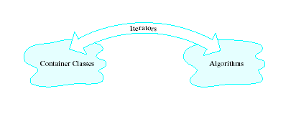
Standard Template Library
Example of a specific
  container class
  iterator
  algorithm

Slide 32
STL's 10 Containers
Kind of Container STL Containers
Sequential: deque, list, vector
Associative: map, multimap,
multiset, set
Adapters: priority_queue,
queue, stack
Non-STL: bitset, valarray,
string

Slide 33
The vector Container
A type-independent pattern for an array class
  capacity can expand
  self contained
Declaration
    template <typename T>
    class vector
    { . . . } ;

Slide 34
The vector Container
Constructors
vector<T> v, // empty vector
v1(100), // 100 elements of type T
v2(100, val), // 100 copies of val
v3(fptr,lptr); // contains copies of
// elements in memory
// locations fptr to lptr

Slide 35
vector Operations
Information about a vector's contents
  v.size()
  v.empty()
  v.capacity()
  v.reserve()
Adding, removing, accessing elements
  v.push_back()
  v.pop_back()
  v.front()

Slide 36
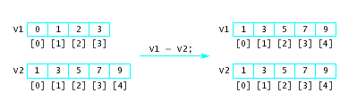
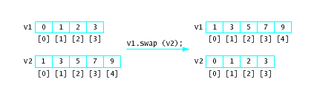
vector Operations
Assignment
v1 = v2
Swapping
v1.swap(v2)
Relational operators
  == implies element by element equality
  less than < behaves like string comparison

Slide 37
Increasing Capacity of a Vector
When vector v becomes full
  capacity increased automatically when item added
Algorithm to increase capacity of vector<T>
  Allocate new array to store vector's elements
  use T copy constructor to copy existing elements to new array
  Store item being added in new array
  Destroy old array in vector<T>
  Make new array the vector<T>'s storage array

Slide 38
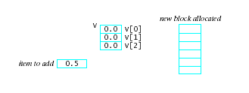
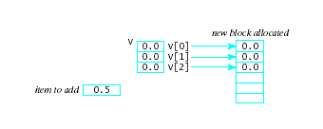
Increasing Capacity of a Vector
Allocate new array
  Capacity doubles when more space needed
Elements copied to new array

Slide 39
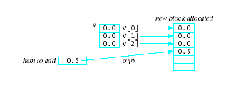
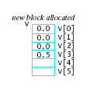
Increasing Capacity of a Vector
Item being added now stored
Destroy old array
Make new array
the vector's storage
area

Slide 40
Iterators
Note from table that a subscript operator is provided
  BUT … this is not a generic way to access container elements
STL provides objects called iterators
  can point at an element
  can access the value within that element
  can move from one element to another
They are independent of any particular container … thus a generic mechanism

Slide 41
Iterators
Given a vector which has had values placed in the first 4 locations:
v.begin() will return the iterator value for the first slot,
v.end() for the next empty slot
vector<int> v
9 | 4 | 15 | 3
v.begin()
v.end()

Slide 42
Iterators
Each STL container declares an iterator type
  can be used to define iterator objects
To declare an iterator object
  the identifier iterator must be preceded by
    name of container
    scope operator ::
Example:
vector<int>:: vecIter = v.begin()

Slide 43
Iterators
Basic operators that can be applied to iterators:
  increment operator ++
  decrement operator --
  dereferencing operator *
  Assignment =
  Addition, subtraction +, -, +=, -=
  vecIter + n returns iterator positioned n elements away
  Subscript operator [ ]
  vecIter[n] returns reference to n^{th} element from current position

Slide 44
Iterators
Contrast use of subscript vs. use of iterator
ostream & operator<<(ostream & out, const vector<double> & v)
{
for (int i = 0; i < v.size(); i++)
out << v[i] << " ";
return out;
}
for (vector<double>::iterator it = v.begin();
it != v.end(); it++)
out << *it << " ";

Slide 45
Iterator Functions
Note Table 9-5, pg 498
Note the capability of the last two groupings
  Possible to insert, erase elements of a vector anywhere in the vector
  Must use iterators to do this
  Note also these operations are as inefficient as for arrays due to the shifting required

Slide 46
Contrast Vectors and Arrays
Vectors | Arrays
Capacity can increase A self contained object Is a class template Has function members to do tasks | Fixed size, cannot be changed during execution Cannot "operate" on itself Must "re-invent the wheel" for most actions

Slide 47
Case Study: Counting Computer Logins
Problem: Login information for each user on a system recorded in a file. We wish to compile a log of information for distinct users
Object involved is log of user's information
Operations on this object include building the object by
  Reading login info for user from file
  Searching log for user's login info
  Add information if not already in file

Slide 48
Case Study: Counting Computer Logins
Linear search algorithm will be used
Fig. 9.5 shows declaration of class LoginLog
Fig 9.6 shows program to use class LoginLog

Slide 49
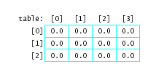
Multidimensional vectors (Optional)
Consider a vector whose elements are themselves vectors
  A vector of vectors
Example
vector < vector<double> > table (ROWS,
vector <double> (COLUMNS, 0, 0);

Slide 50
Two-D vector Operations
Subscript
  Single table[0] refers to one row of table
  Double-subscript table[1][3] refers to an element within specified row

Slide 51
Two-D vector Operations
The size() method
  table.size() gives number of rows
  table[0].size() gives number of elements in a row (effectively the number of columns)
The push_back() method
  table.push_back (vector<double>(COLUMNS,0.0);
  adds another row
  To add another column, what would it take??
  Note: possible to create tables with rows of different sizes!

Slide 52
STL's deque Container
As an ADT, a deque is a double-ended queue
  It is a sequential container
  Acts like a queue (or stack) on both ends
  It is an ordered collection of data items
  Items can only be added or removed at the ends

Slide 53
deques
Basic operations
Construct a deque (usually empty):
Check if the deque is empty
Push_front:
  Add an element at the front of the deque
Push_back:
  Add an element at the back of the deque

Slide 54
deques
Basic operations (ctd.)
Front:
  Retrieve the element at the front of the deque
Back:
  Retrieve the element at the back of the deque
Pop_front:
  Remove the element at the front of the deque
Pop_back:
  Remove the element at the back of the deque
View Fig. 9.7, Demonstration of STL's deque

Slide 55
STL's deque Class Template
Has the same operations as vector<T> except …
  there is no capacity() and no reserve()
Has two new operations:
  d.push_front(value);
  Push copy of value at front of d
  d.pop_front(value);
  Remove value at the front of d

Slide 56
STL's deque Class Template
Like STL's vector, it has several operations that are not defined for deque as an ADT:
  [ ] subscript operator
  insert and delete at arbitrary points in the list, same kind of iterators.
But: insertion and deletion are not efficient
  in fact, take longer than for vectors.

Slide 57
vector vs. deque
vector | deque
Capacity of a vector must be increased It must copy the objects from the old vector to the new vector It must destroy each object in the old vector A lot of overhead! | With deque this copying, creating, and destroying is avoided. Once an object is constructed, it can stay in the same memory locations as long as it exists If insertions and deletions take place at the ends of the deque.

Slide 58
vector vs. deque
Unlike vectors, a deque isn't stored in a single varying-sized block of memory, but rather in a collection of fixed-size blocks (typically, 4K bytes).
One of its data members is essentially an array map whose elements point to the locations of these blocks.

Slide 59
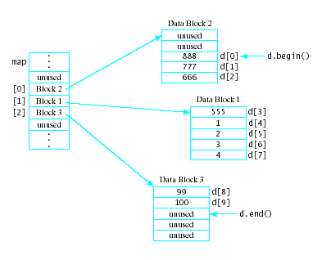
Storage for A deque
Example:
a deque with
666, 777, 888,
6, 5 in this
order, from front
to back
When a data block
gets full, a new one
is allocated and its
address is added to map.

Slide 60
Storage for A deque
When map gets
full, a new one is
allocated
The current values
are copied into the
middle of it.
Inserts and deletes
may involve cross-
block element-shifting!

Slide 61
A deque-Based Stack Template
Stack can become full
  Possible (poor) solution was to use dynamic arrays and go through complicated algorithm to increase capacity
  Better solution was to use linked-list implementation
Alternative solution
  Create a Stack using a deque
  See Fig. 9.9

Slide 62
STL's stack Adapter
STL stack container
  Actually an adapter
  Indicated by container type as one of its type parameters
  stack <T, C<T> > aStack;
If no container specified stack <T> astack;
  Default is deque
  Also possible to specify a vector or list as the container for the stack

Slide 63
STL's queue Adapter
A queue can be specified
queue<T, C<T> > aQueue;
  Where C may be any container supporting
  push_back() and pop_front()
The default container is deque
  Could also use
  queue <T, list<T> > aQueue;

Slide 64
Bitsets
The C++ standard includes bitset as a container,
  but it is not in STL.
A bitset is an array whose elements are bits.
  Much like an array whose elements are of type bool,
Unlike arrays, bitset provides operations for manipulating the bits stored in it.
They provide an excellent data structure to use to implement sets.

Slide 65
Bitsets
Operations provided
  Bitwise and &, bitwise or |, bitwise xor ^
  Assignment operators
  Relational operators
  Subscript operator
Function members for bitset<10> b
  b.set() b.flip(i)
  b.reset() b.size()
  b.set (i, bv) b.count()
  b.reset(i) b.any()
  b.flip() b.none()
  b.test(i)

Slide 66
ValArrays
The standard C++ library also provides the valarray class template,
  Designed to carry out (mathematical) vector operations very efficiently.
  Highly optimized for numeric computations.
Operators provided
  subscript
  assignment
  unary +, -, ~, !
  size
  resize(n,val)

Slide 67
ValArrays
Auxiliary types that specify subsets of a valarray
  slice_array
  gslice_array
  mask_array
  indirect_array

